Slide 1

SIT1302 Internet Programming
UNIT 1
MARKUP LANGUAGE

Slide 2
HTML Links
The HTML <a> tag defines a hyperlink. It has the following syntax:
<a href="url">link text</a>
The most important attribute of the <a> element is the href attribute, which indicates the link's destination.
The link text is the part that will be visible to the reader.
Clicking on the link text, will send the reader to the specified URL address.

Slide 3
HTML Code
<!DOCTYPE html>
<html>
<body>
<h1>The a element</h1>
<a href="http://www.sathyabama.ac.in/">
Visit Sathyabama!!!!!
</a>
</body>
</html>

Slide 4
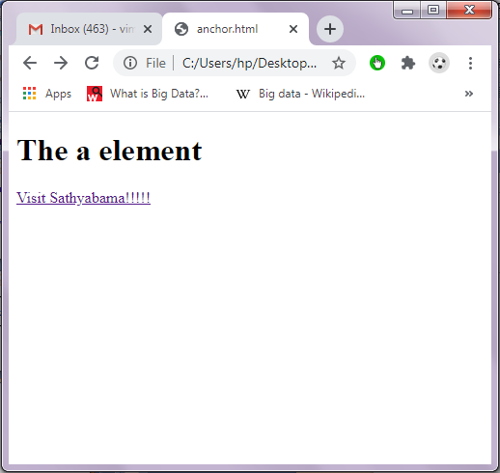
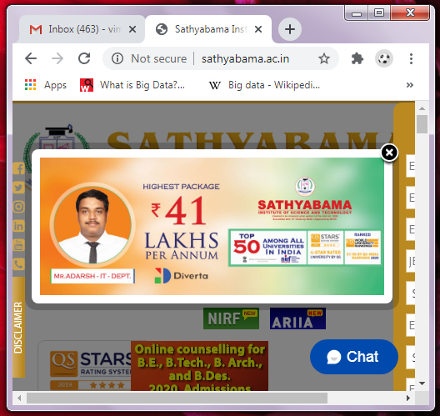
Output

Slide 5
HTML Link Colors
By default, a link will appear like this (in all browsers):
An unvisited link is underlined and blue
A visited link is underlined and purple
An active link is underlined and red
You can change the link state colors, by using CSS

Slide 6
HTML Images
The HTML <img> tag is used to embed an image in a web page.
Images are not technically inserted into a web page; images are linked to web pages. The <img> tag creates a holding space for the referenced image.
The <img> tag is empty, it contains attributes only, and does not have a closing tag.
The <img> tag has two required attributes:
src - Specifies the path to the image
alt - Specifies an alternate text for the image

Slide 7
Syntax
<img src="url" alt="alternatetext">
Example 1
<img src="img_chania.jpg" alt="Flowers in Chania">
Example 2
<img src="img_girl.jpg" alt=“A Girl” width=“500" height="600">
Example 3
<img src="/images/html5.gif" alt="HTML5 Icon" style="width:128px;height:128px;">

Slide 8
Image as a Link
To use an image as a link, put the <img> tag inside the <a> tag:
Example
<a href="default.asp"> <img src="smiley.gif" alt="HTML tutorial" style="width:42px;height:42px;">
</a>

Slide 9
HTML Tables
HTML tables allow web developers to arrange data into rows and columns.
The <table> tag defines an HTML table.
Each table row is defined with a <tr> tag. Each table header is defined with a <th> tag. Each table data/cell is defined with a <td> tag.
By default, the text in <th> elements are bold and centered.
By default, the text in <td> elements are regular and left-aligned.

Slide 10
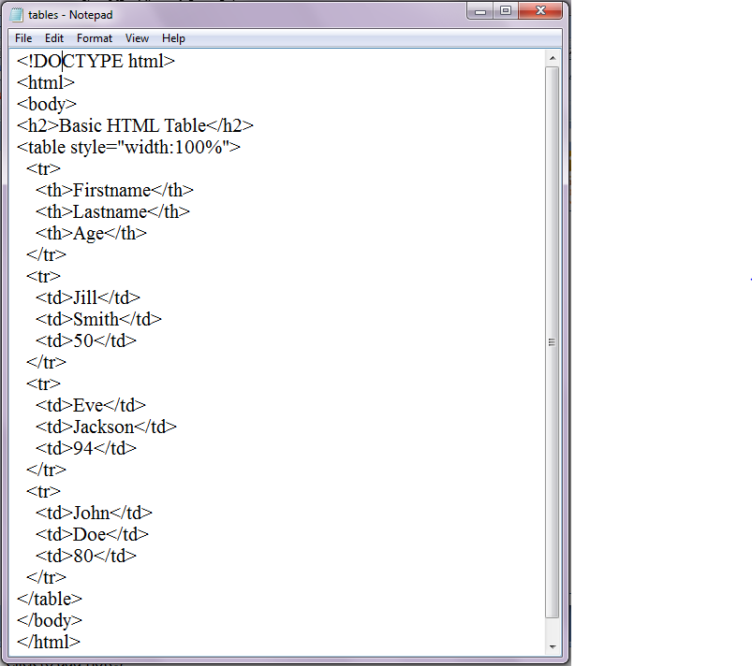
Example

Slide 11
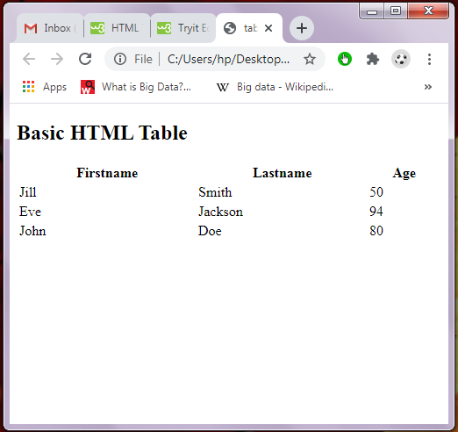
Output

Slide 12
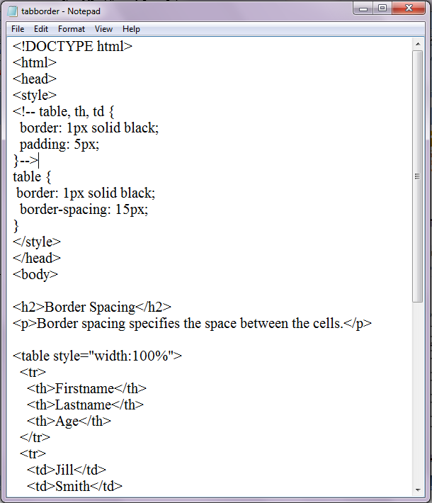

Slide 13
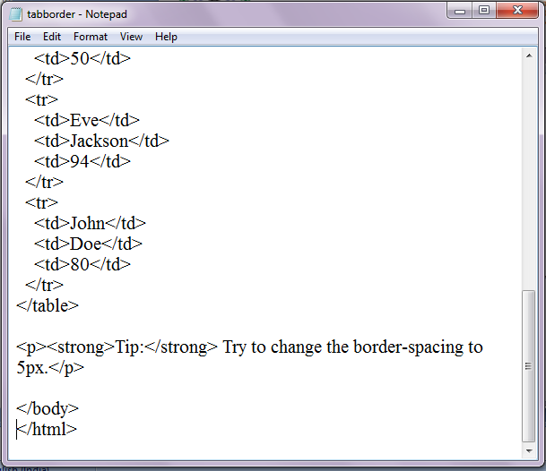

Slide 14
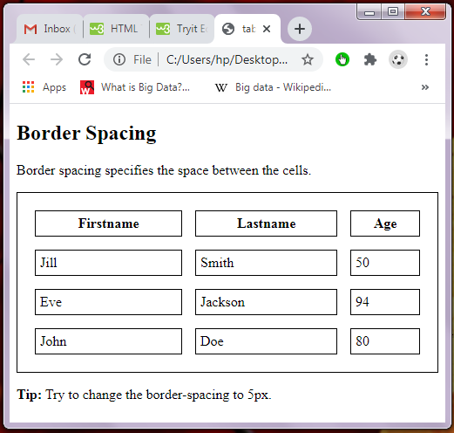
Output

Slide 15
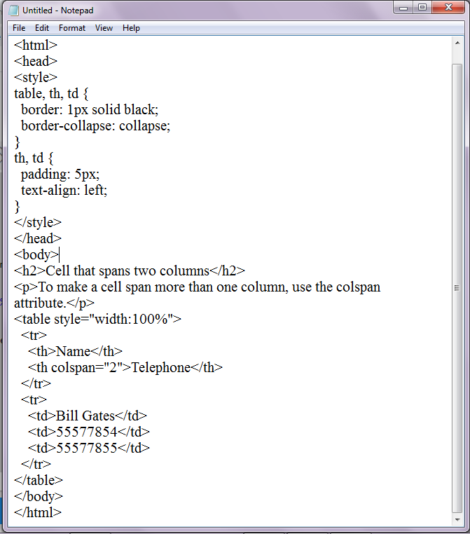
Colspan

Slide 16
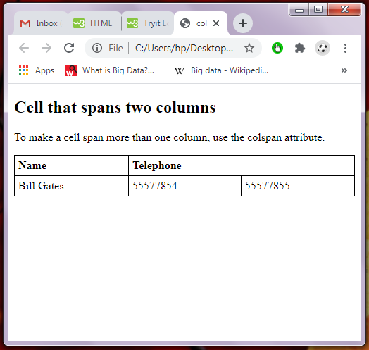
Output

Slide 17
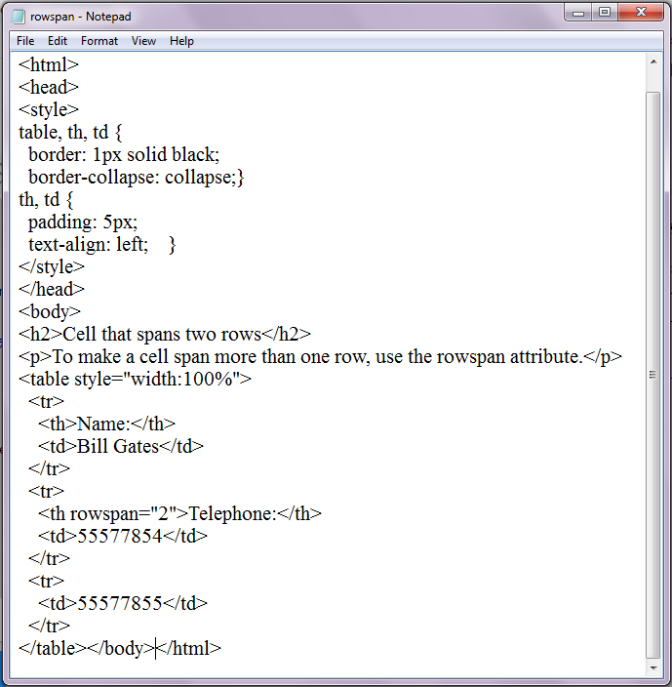
Rowspan

Slide 18
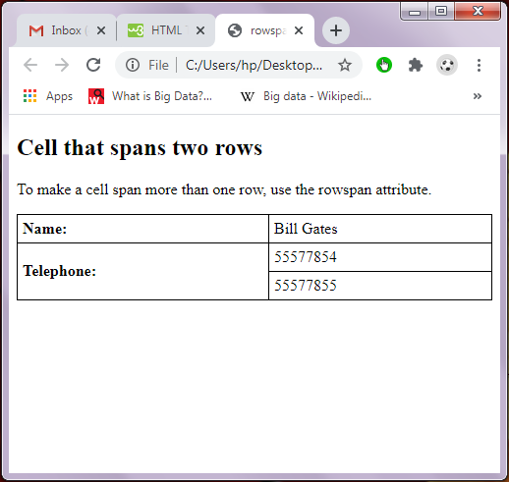
Output

Slide 19
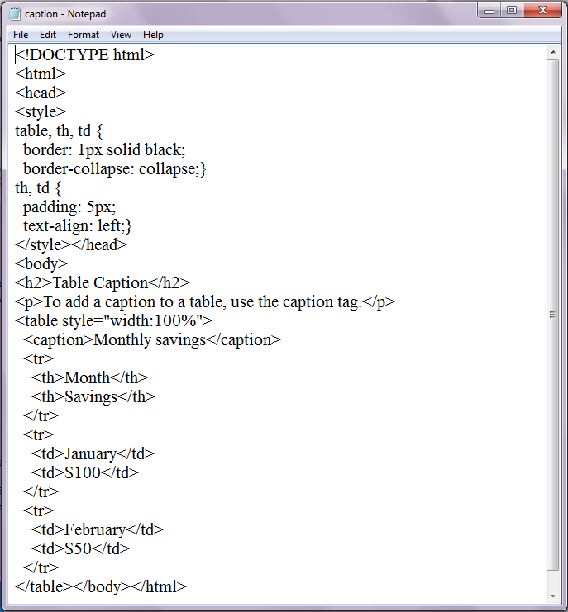
Table Caption

Slide 20
Lists
<!DOCTYPE html>
<html>
<body>
<h2>An Unordered HTML List</h2>
<ul>
<li>Coffee</li>
<li>Tea</li>
<li>Milk</li>
</ul>
<h2>An Ordered HTML List</h2>
<ol>
<li>Coffee</li>
<li>Tea</li>
<li>Milk</li>
</ol>
</body>
</html>

Slide 21
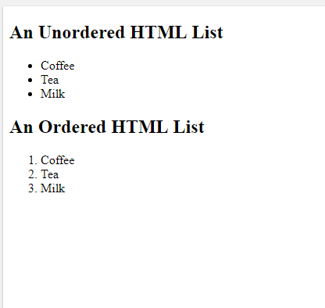
Output

Slide 22
Unordered HTML List
An unordered list starts with the <ul> tag. Each list item starts with the <li> tag.
The list items will be marked with bullets (small black circles) by default:
Example
<ul> <li>Coffee</li> <li>Tea</li> <li>Milk</li>
</ul>

Slide 23
Ordered HTML List
An ordered list starts with the <ol> tag. Each list item starts with the <li> tag.
The list items will be marked with numbers by default:
Example
<ol> <li>Coffee</li> <li>Tea</li> <li>Milk</li> </ol>

Slide 24
HTML Description Lists
HTML also supports description lists.
A description list is a list of terms, with a description of each term.
The <dl> tag defines the description list, the <dt> tag defines the term (name), and the <dd> tag describes each term:
Example
<dl> <dt>Coffee</dt> <dd>- black hot drink</dd> <dt>Milk</dt> <dd>- white cold drink</dd> </dl>

Slide 25
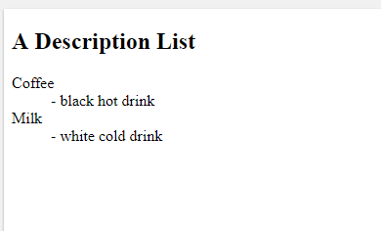
Output

